Slide 1
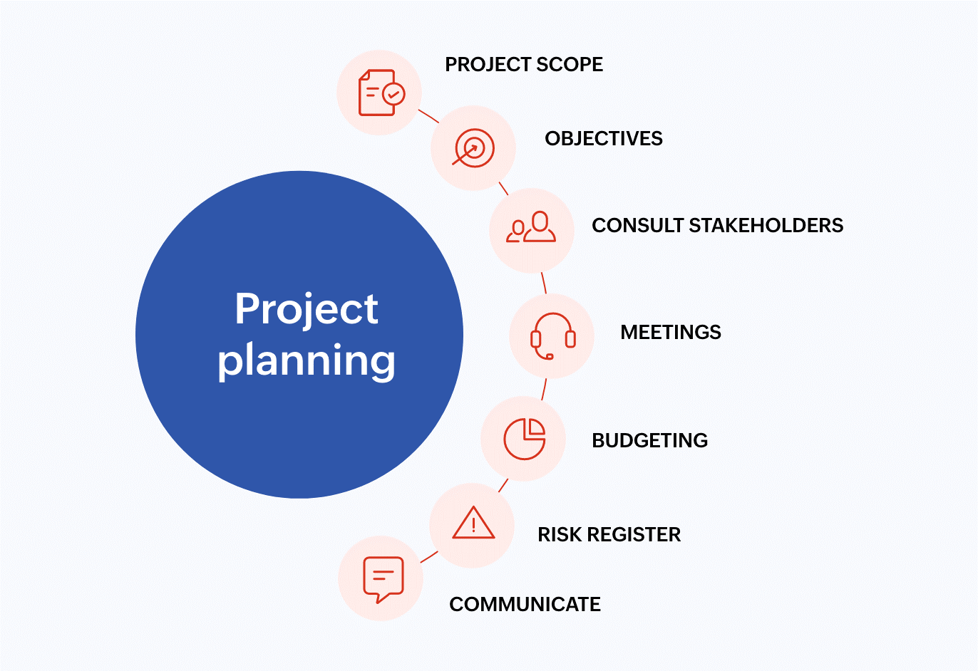
Chapter 5 Software Project Planning
Assit.prof. Juthawut Chantharamalee
Curriculum of Computer Science
Faculty of Science and Technology, Suan Dusit University

Slide 2
Outline of this presentation
1. Project Planning
2. WBS-Work Breakdown Structure
3. PERT-Program Evaluation and Review Technique
4. Software Cost Estimation

Slide 3
5.1 Project Planning
Planning is essential and software development is no exception. Achieving success in software development requires planning. Software project planning involves deciding what tasks need to be done, in what order to do the tasks, and what resources are needed to accomplish the tasks.

Slide 4
5.2 WBS—Work Breakdown Structure
One of the first tasks is to break the large tasks into small tasks. It means finding identifiable parts of the tasks. It also means finding deliverables and milestones that can be used to measure progress.

Slide 5
The work breakdown structure (WBS) should be a tree structure. The top-level breakdown usually matches the life cycle model (LCM) used in the organization. The next-level breakdown can match the processes in the organization’s process model (PM). Further levels are used to partition the task into smaller, more manageable tasks.

Slide 6
The following are rules for constructing a proper work breakdown structure:
1. The WBS must be a tree structure.
There should be no loops or cycles in the WBS. Iterative actions will be shown in the process model and/or the life cycle model.

Slide 7
2. Every task and deliverable description must be understandable and unambiguous.
The purpose of a WBS is communication with team members. If the team members misinterpret what the task or deliverable is supposed to be, there will be problems.

Slide 8
3. Every task must have a completion criterion (often a deliverable).
There must be a way to decide when a task is completed, because subtasks that have no definite ending encourage false expectations of progress. This decision is called a completion criterion. It may be a deliverable, for example, a complete design for the project, and then a peer review can decide if it is complete.

Slide 9
4. All deliverables (artifacts) must be identified.
A deliverable must be produced by some task or it won’t be produced.
5. Positive completion of the tasks must imply completion of the whole task.
The purpose of the work breakdown schedule is to identify the subtasks necessary to complete the whole task. If important tasks or deliverables are missing, the whole task will not be accomplished.

Slide 10
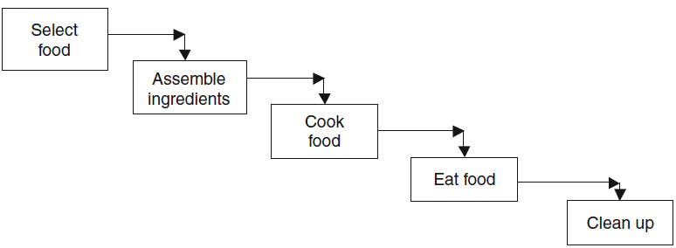
Example 5.1
In making a loaf of bread, the life cycle model for cooking.
Fig. 5-1. Life cycle model for cooking.

Slide 11
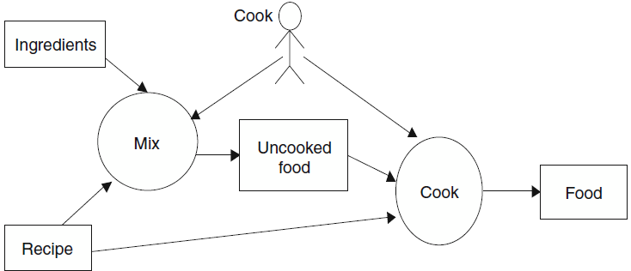
Example 5.2
The process model for cooking.
Fig. 5-2. Cooking process model.

Slide 12
Example 5.2
Team XYZ wants to develop a face recognition system for use on the robot. The system is intended to greet visitors to the robotics laboratory. It should recognize faces it has seen before with a reasonable reliability. The first pass on the work breakdown might recognize the following subtasks.

Slide 13
Example 5.2
Feasibility
Determine feasibility of vision.
Determine camera and software availability.
Schedule camera and vision software acquisition.
Risk Analysis
Determine vision risks.
Design
Design prototypes.
Prototype vision.

Slide 14
Implementation
Code the image capture.
Code the image processing.
Code the image comparison.
Integrate with other robot software.
Testing
Test image capture.
Delivery
Document.

Slide 15
5.3 PERT—Program Evaluation and Review Technique
This technique creates a graph that shows the dependencies among the tasks. Each task has an estimate of the time necessary to complete the task and a list of other tasks that have to be completed before this task can be started (dependencies).

Slide 16
The graph may not always have only one starting subtask or only one stopping subtask. The whole task is only completed when all the subtasks are completed. The graph can be used to calculate the completion times for all the subtasks, the minimum completion time for the whole task, and the critical path of the subtasks.

Slide 17
5.3.1 ALGORITHM FOR COMPLETION TIMES
1. For each node, do step 1.1 (until completion times of all nodes are calculated)
1.1 If the predecessors are completed, then take the latest completions time of the predecessors and add required time for this node.
2. The node with the latest completion time determines the earliest completion
time for project.

Slide 18
Example 5.3
Apply this algorithm to Table 4-1, which shows an example of tasks and dependencies. The same dependencies are shown in Fig. 4-3. To apply the completion time algorithm, start with subtask a;it has no dependencies, so it can start at the initial time (say, 0). It can complete at time 0 + 8 = 8. Similarly, subtask b can complete at time 0 + 10 = 10.

Slide 19
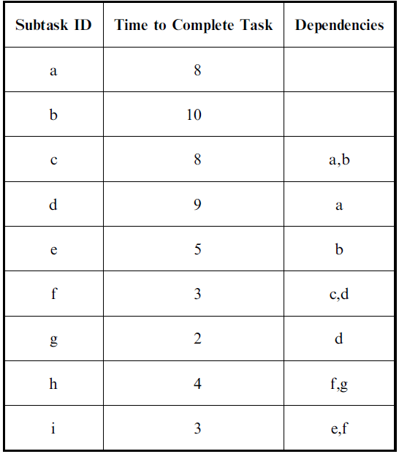
Table 5-1 Subtasks

Slide 20
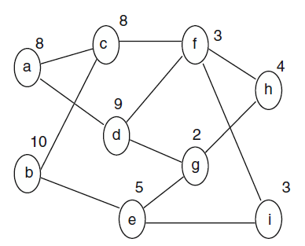
Example 5.3
Fig. 5-3. PERT diagram.

Slide 21
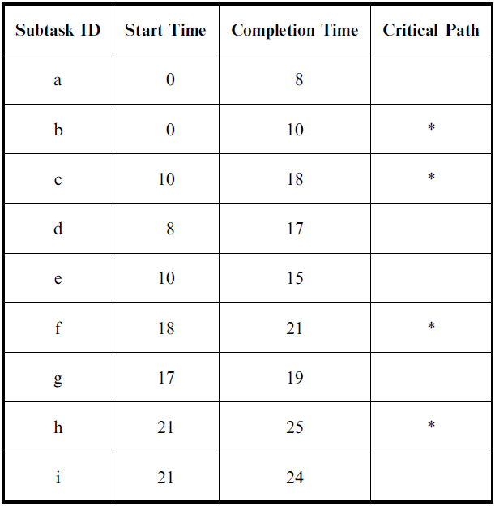
Table 5-2 Subtasks

Slide 22
Example 5.3
Since the completion times for subtasks a and b are now calculated, the completion times for nodes c, d, and e can be calculated. Since the predecessors of c finish at 8 and 10, subtask c can start at 10 and complete at 10 + 8 = 16. The
start time for d will be 8 and the completion time can be 8 + 9 = 17, and for e the times will be 10 and 10 + 5 = 14.

Slide 23
Example 5.3
Now we can process subtasks f and g. The start times can be 17 and 16, respectively. The completion times will be 17 + 3 = 20 for f and 16 + 2 = 18 for g. Subtasks h and i can now be calculated with both starting at 21 and h competing at 25 and i at 24. Table 4-2 has all of the start and completion times.

Slide 24
5.3.2 CRITICAL PATH
The critical path is the set of tasks that determines the shortest possible completion time. The completion time will be longer if there are insufficient resources to do all parallel activities. However, the completion time can never be made shorter by adding more resources.

Slide 25
5.3.3 ALGORITHMFOR MARKING CRITICAL PATH
1. Start with the node(s) with the latest completion time(s); mark it (them) as critical.
2. Select the predecessor(s) of the critical node(s) with latest completion time(s); mark it (them) as critical. Continue Step 2 until reaching the starting node(s).

Slide 26
Example 5.4
In Table 4-2 we can see the completion times of all of the subtasks. Subtask h has the latest completion time, 25. Thus, we mark h as part of the critical path. The predecessors of h are f and g. Subtask f has the latest completion time of those two subtasks, so f is marked as part of the critical path. Subtask f has c and d as predecessors. Since c has the later completion time, c is marked as part of the critical path. Subtask c has a and b as predecessors, and since b has the later time, it is part of the critical path. Since we are now at an initial subtask, the critical path is complete.

Slide 27
5.3.4 SLACK TIME
Subtasks that are on the critical path have to be started as early as possible or else the whole project will be delayed. However, subtasks that are not on the critical path have some flexibility on when they are started. This flexibility is called the slack time.

Slide 28
5.3.5 ALGORITHMFOR SLACK TIME
1. Pick the noncritical node with the latest ending time that has not been processed. If the subtask has no successors, pick the latest ending time of all nodes. If the subtask has successors, pick the earliest of the latest start times of the successor nodes. This is the latest completion time for this subtask. Make the latest start time for this subtask to reflect this time.
2. Repeat Step 1 until all noncritical path subtasks have been processed.

Slide 29
Example 5.5
The noncritical subtask with the latest completion time is subtask i. Since it has no successors, the latest completion time, 25, is used. This is added as the latest
completion time for i. Since 25 is 1 later than 24, the start time is changed from 21 to 21,22. Now the latest non processed, noncritical subtask is g. Since h is the only successor of g, and h must start by 21, g must end by 21. So the completion time of g comes 19,21 and the start time becomes 17,19. The next subtask to be processed will be d. It has successors f and g.

Slide 30
Subtask f has to start by 18, so d’s completion becomes 17,18, and its start becomes 8,9. The next subtask to be processed will be e. Subtask e has g and i as successors. Subtask g’s latest start time is 19 and i’s is 22, so subtask e becomes 10,14 for start times and 15,19 for completion times. The last subtask to be processed is a. It has successors c and d. Subtask a has to complete by 9, so the completion time will be 8,9, and its start time will be 0,1. Table 4-3 summarizes the results.

Slide 31
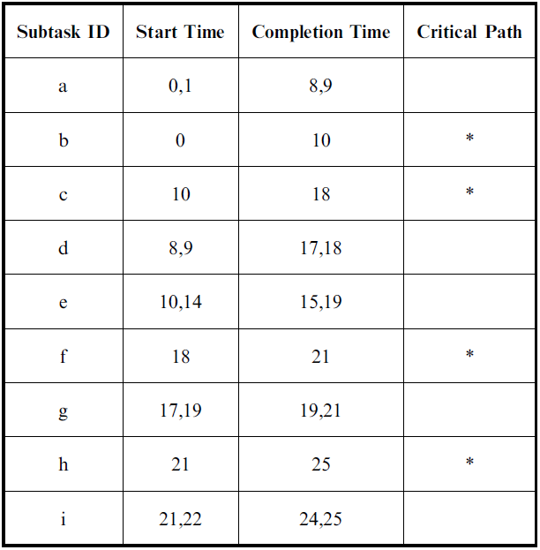
Table 5-3 Subtasks with Slack Time

Slide 32
Example 5.6
Open MS Project (version 98). Select PERT view on left menu. Under the Insert pull-down menu, insert a new task. Use the right mouse button to open task information. Change the time for the task to 5 days. Drag from this task to create anew task with a dependency on the first task, or go to the Insert menu to insert another new task. Create the tasks and dependencies from Example 4.5. The tasks on the critical path will be shown in red. Use the left menu bar to see the Gannt chart view of this project.

Slide 33
5.4 Software Cost Estimation
The task of software cost estimation is to determine how many resources are needed to complete the project. Usually this estimate is in programmer-months (PM).
There are two very different approaches to cost estimation. The older approach is called LOC estimation, since it is based on initially estimating the number of lines of code that will need to be developed for the project. The newer approach is based on counting function points in the project description..

Slide 34
5.4.1 ESTIMATION OF LINES OF CODE (LOC)
The first step in LOC-based estimation is to estimate the number of lines of code in the finished project. This can be done based on experience, size of previous projects, size of a competitor’s solution, or by breaking down the project into smaller pieces and then estimating the size of each of the smaller pieces.

Slide 35
A standard approach is, for each piece_{i}, to estimate the maximum possible size, max_{i}, the minimum possible size, min_{i}, and the ‘‘best guess’’ size, best_{i}. The estimate for the whole project is 1/6 of the sum of the maximums, the minimums, and 4 times the best guess:

Slide 36
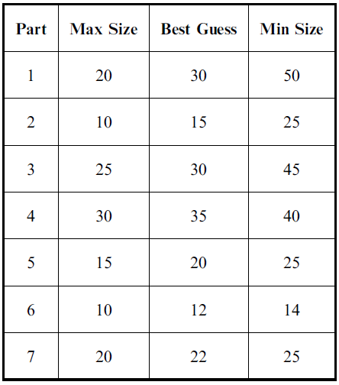
Example 5.7
Team WRT had identified seven sub pieces to their project. These are shown in Table 5-4 with their estimates of the size of each sub piece.
Table 5-4 Sub piece
Size Estimate (in LOC)

Slide 37
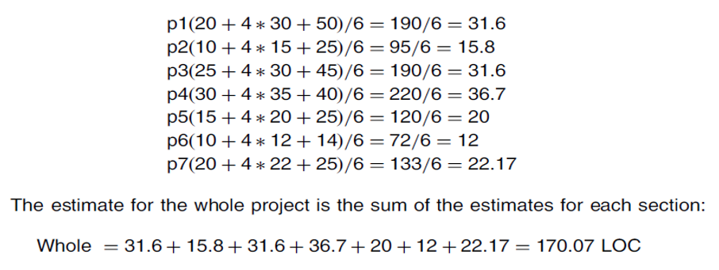
The estimates for each section are as follows:

Slide 38
5.4.2 LOC-BASED COST ESTIMATION
The basic LOC approach is a formula that matches the historical data. The basic formula has three parameters:
Alpha,α, is the marginal cost per KLOC (thousand lines of code). This is the added cost for an additional thousand lines of code. The parameter beta, β, is an exponent that reflects the nonlinearity of the relationship.

Slide 39
A value of beta greater than 1 means that the cost per KLOC increases as the size of the project increases. This is a diseconomy of scale. A value of beta less than 1 reflects an economy of scale. Some studies have found betas greater than 1, and other studies have betas less than 1. The parameter gamma, γ, reflects the fixed cost of doing any project. Studies have found both positive gammas and zero gammas.

Slide 40
Example 5.8
Company LMN has recorded the following data from previous projects. Estimate what the parameters for the cost estimation formula should be and how much effort a new project of 30 KLOC should take (see Table 5-5).

Slide 41
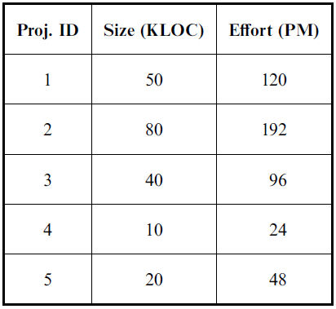
Table 5-5 Historical Data
Analyzing or plotting this data would show a linear relationship between size and effort. The slope of the line is 2.4. This would be alpha, , in the LOC-based cost estimation formula. Since the line is straight (linear relationship), the beta, , is 1. The gamma, , value would be zero.

Slide 42
5.4.3 CONSTRUCTIVE COST MODEL (COCOMO)
COCOMO is the classic LOC cost-estimation formula. It was created by Barry Boehm in the 1970s. He used thousand delivered source instructions (KDSI) as his unit of size. KLOC is equivalent. His unit of effort is the programmer-month (PM).

Slide 43
5.4.3 CONSTRUCTIVE COST MODEL (COCOMO)
Boehm divided the historical project data into three types of projects:
1. Application (separate, organic, e.g., data processing, scientific)
2. Utility programs (semidetached, e.g., compilers, linkers, analyzers)
3. System programs (embedded)

Slide 44
5.4.3 CONSTRUCTIVE COST MODEL (COCOMO)
He determined the values of the parameters for the cost model for determining effort:

Slide 45
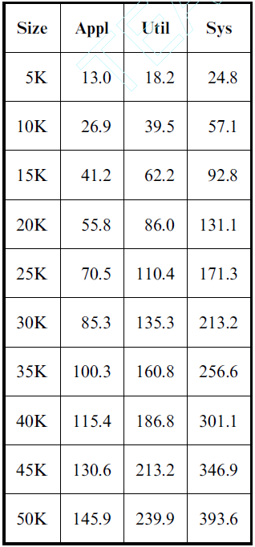
Example 5.9
Calculate the programmer effort
for projects from 5 to 50 KDSI (seeTable 5-6)

Slide 46
5.4.3 CONSTRUCTIVE COST MODEL (COCOMO)
Boehm also determined that in his project data, there was a standard development time based on the type of project and the size of the project. The following are the formulas for development time (TDEV) in programmer-months:

Slide 47
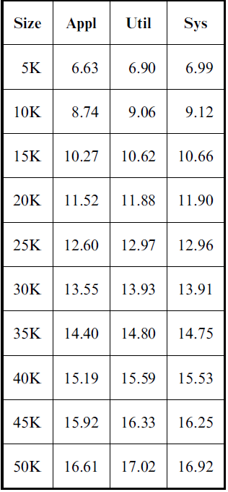
Example 5.10 Table 5-7 COCOMO Development Time
Calculate the standard TDEV using the COCOMO formulas for projects from 5 to 50 KDSI (see Table 5-7).

Slide 48
5.4.4 FUNCTION POINT ANALYSIS
The idea of function points is to identify and quantify the functionality required for the project. The idea is to count things in the external behavior that will require
processing. The classic items to count are as follows:
1. Inquiries
2. Inputs
3. Outputs
4. Internal files
5. External interfaces

Slide 49
1. Inquiries are request-response pairs that do not change the internal data.
For example, a request for the address of a specified employee is an inquiry. The whole sequence of asking, supplying the name, and getting the address would count as one inquiry.
2. Inputs are items of application data that is supplied to the program.
The logical input is usually considered one item and individual fields are not usually counted separately. For example, the input of personal data for an employee might be considered one input.

Slide 50
3. Outputs are displays of application data.
This could be a report, a screen display, or an error message. Again, individual fields are usually not considered separate outputs. If the report has multiple lines, for instance, a line for each employee in the department, these lines would all be counted as one output. However, some authorities would count summary lines as separate outputs.

Slide 51
4. Internal files are the logical files that the customer understands must be maintained by the system.
If an actual file contained 1000 entries of personnel data, it would probably be counted as one file. However, if the file contained personnel data, department summary data, and other department data, it would probably be counted as three separate files for the purposes of counting function points.
5. External interfaces are data that is shared with other programs.
For example, the personnel file might be used by human resources for promotion and for payroll. Thus, it would be considered an interface in both systems.

Slide 52
5.4.4.1 Counting Unadjusted Function Points
The individual function point items are identified and then classified as simple, average, or complex. The weights from Table 5-8 are then assigned to each item and the total is summed. This total is called the unadjusted function points.

Slide 53
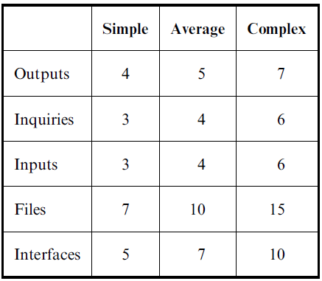
Table 5-8 Function Point Weights
There is no standard for counting function points. Books have been written with different counting rules. The important thing to remember is that function points are trying to measure the amount of effort that will be needed to develop the software. Thus, things that are related to substantial effort need to generate more function points than things that will take little effort.

Slide 54
Example 5.11
The department wants a program that assigns times and rooms for each section and creates a line schedule for the courses. The department has a list of sections with the name of the assigned professor and the anticipated size. The department also has a list of rooms with the maximum number of students each room will hold There are also sets of classes that cannot be taught at the same time. Additionally, professors cannot teach two courses at the same time.

Slide 55
5.4.5 PRODUCTIVITY
One of the important measures is the productivity of the software developers. This is determined by dividing the total size of the finished product by the total effort of all the programmers. This has units of LOC/programmer-day. An alternative is to measure the productivity in terms of function points per programmer-day. Note that productivity includes all the effort spent in all phases of the software life cycle.

Slide 56
Example 5.12
Company XYZ spent the following effort for each life cycle phase of the latest project (see Table 4-9). Calculate the effort in terms of LOC/programmer-day and in terms of function points/programmer day. The function point estimate was 50 unadjusted function points. The finished project included 950 lines of code.

Slide 57
5.4.6 EVALUATING ESTIMATIONS
To evaluate estimations, a measure needs to be calculated. Tom DeMarco proposed the estimate quality factor (EQF). DeMarco defines the EQF as the area under the actual curve divided by area between the estimate and the actual value. This is the inverse of the percentage error or the mean relative error. Thus, the higher the EQF, the better was the series of estimates. DeMarco said that values over 8 are reasonable.

Slide 58
Example 5.13
The following estimates were given for a project that cost 3.5 million dollars when it was completed after 11.5 months:
The total area is 11.5 months times 3.5 million = 40.25 million month-dollars. The difference between the actual curve and the estimate is |2.3-3.5|*1.5+|3.1*3.5|*4+|3.9-3.5|*2.5 +|3.4-3.5|*3.5=4.75 million month-dollars. The ratio is 40.25/4.75=8.7.

Slide 59
5.4.7 AUTOMATED ESTIMATION TOOLS
Numerous tools are available on the Internet that will calculate COCOMO or COCOMO2. Most have very simple interfaces. Search for COCOMO using any browser, and it should find multiple sites.

